Slide 1

FIND FLIGHT
FLIGHT FARE PREDICTION

Slide 2
Introduction
Everybody knows that holidays always call for a much-needed vacation and finalizing the travel itinerary becomes a tedious task. With the worldwide growth of internet and E-commerce, commercial aviation industry has witnessed a tremendous growth and has become a regulated marketplace. [1] Hence, for Airline revenue management, different strategies like customer profiling, financial marketing, social factors are used for setting ticket fairs. It is often seen that airfares are low when tickets are booked months in advanced and then they rise when booked in urgency. [2]. But, number of days/hours until departure isn’t the only factor which decides flight fare, there are numerous other factors as well.
Because of this complex pricing model of aviation industry, customers find it very difficult to find a perfect and cheapest ticket deal. To solve this problem, Machine Learning and Deep Learning based several technologies and modals are developed and extensive research is also underway.
In this project , we will all the steps required for price prediction of a flight.

Slide 3
Business problem
Company like Find Flight predict fare of the flight for the customers , But the question is why?
For the Business Purpose the Airlines companies change price according to the seasons or time duration. They will increase the price when people travel more. Many people don’t know these things and fall into the trap of Airline company.

Slide 4
Objective
The main objective of this project to determine ideal purchase time for flight ticket and help customer to predict future flight prices and plan their journey accordingly.
Company like Find Flight helps customer to find the flight according to their time , interest and budget. So, that customer don’t have to pay more .

Slide 5
Factors that affect flight ticket prices
Distance: Primarily, distance plays a pivotal role in determining the flight ticket prices. Depending on the distance that you wish to travel, the flight ticket rates also vary. The farther the distance, the more the travel time, the more expensive the flight ticket price is. It is considered to be almost in direct relation with the pricing system of flight tickets. Although it is not a deciding factor to affect the ticket rates, it certainly does play a role in impacting the flight ticket prices.
Peak season: Second most important factor that determines the flight ticket rates is seasonality. Certain places in the world are known to be populated by tourists during a specific time of the year. Depending on the peak season, the prices of the flight tickets also see a drastic spike.
Flight travel type: Flight travel type basically translates to the type of journey that you will be indulging in following a ticket purchase. Travel type determines if you get a direct flight with a less travel time or if you get an indirect flight that has a longer flight duration with less ticket rate.

Slide 6
Timing of Purchase: When you buy your tickets matters. If you buy at the last minute – typically within seven days of departure, as business travelers do –you’ll pay a hefty premium (which is why airlines love their road warriors). The best time to buy domestic tickets is between three-and-a-half months and two or three weeks before departure. The best day to buy is Tuesday, starting at about 3 p.m. E.T. (which is when all airfare sales have been released and competing airlines have matched the new, lower prices).
Competition: The more airlines, the merrier -- for passengers. Fierce competition means lower ticket prices. Recent examples of more airlines causing lower prices: flights to and from Boston and Denver.
Stops: The price of tickets also depends on the number of stops your flight has. If your flight direct then the price will be higher or if has stops then the price will be lower.

Slide 7
Ml pipeline
Gather data
Data Preprocessing
EDA
Feature Engineering
Train/Test split
Model Training
Model Evaluation
Hyper parameter Tuning
Saving the model
Deployment
Business Problem

Slide 8
Data Collection
Machine learning starts with data. But for this data to work, several processes must be carried out. One of them is data collection.
Improper data collection is a significant barrier to efficient machine learning. Hence, data collection has recently become a hotly debated issue in the global tech community
However, the accuracy of the predictions or recommendations produced by ML systems depends on the training data. Yet, several issues might occur during ML data collection that affect the accuracy rate:
Bias. Since humans who construct ML models are prone to bias, data bias is very difficult to prevent and eliminate.
Inaccurate data. The gathered data might not be relevant to the ML problem statement.
Missing data. For some classes of prediction, missing data can represent empty values in columns or missing images.
Data imbalance. A risk of underrepresentation in the model exists for some groups or categories in the data due to an excessively large or low number of corresponding samples.

Slide 9
Data Preprocessing
It’s necessary to preprocess the data after it has been collected to make it ready for an ML task. Data preprocessing is a broad term that encompasses many different tasks, from data formatting to feature creation. Let’s take a look at each of the processes!
Formatting: Unfortunately, we don’t live in a perfect world, where the data is already cleaned and formatted before a data scientist collects it. In a real-case scenario, the data is gathered from various sources and, thus, needs to be formatted. When working with text data, the end dataset is frequently an XLS/CSV file.
Cleaning : Once the data is formatted, it can be easily fed into the model for further training. However, formatted data doesn’t mean it’s free of errors and outliers (aka anomalies) and that all data is properly arranged. The preparation of data before further preprocessing matters since the correct, accurate data has a strong impact on the outcome. This is why data cleaning (or cleansing) is a crucial activity. Data that has been added or categorized incorrectly is removed using manual and automated data cleaning processes, which also helps in dealing with missing data, duplicates, structural errors, and outliers.

Slide 10

Exploratory data analysis
What is Exploratory Data Analysis ?
Exploratory Data Analysis or (EDA) is understanding the data sets by summarizing their main characteristics often plotting them visually. This step is very important especially when we arrive at modeling the data in order to apply Machine learning. Plotting in EDA consists of Histograms, Box plot, Scatter plot and many more. It often takes much time to explore the data. Through the process of EDA, we can ask to define the problem statement or definition on our data set which is very important.
How to perform Exploratory Data Analysis ?
This is one such question that everyone is keen on knowing the answer. Well, the answer is it depends on the data set that you are working. There is no one method or common methods in order to perform EDA.

Slide 11
ABOUT DATASET
Before performing EDA on our dataset , we must about our data, and understand how each features relates to our dependent variable.
Data dictionary:
Airline- The name of the airline company
Date_of_Journey- The date on which the journey happened
Source- The city of the departure of the flight
Destination- The destination city/airport
Route- The route of the flight from where to where
Dep_Time- The departure time of the flight
Arrival_Time- The time of the arrival of the flight to the destination
Duration- The duration of the flight
Total_Stops- Total number of stops during the journey
Additional_Info- Extra/Additional information regarding flight/travel
Price- The price of the ticket for a single journey

Slide 12
DATA STRUCTURE

Slide 13
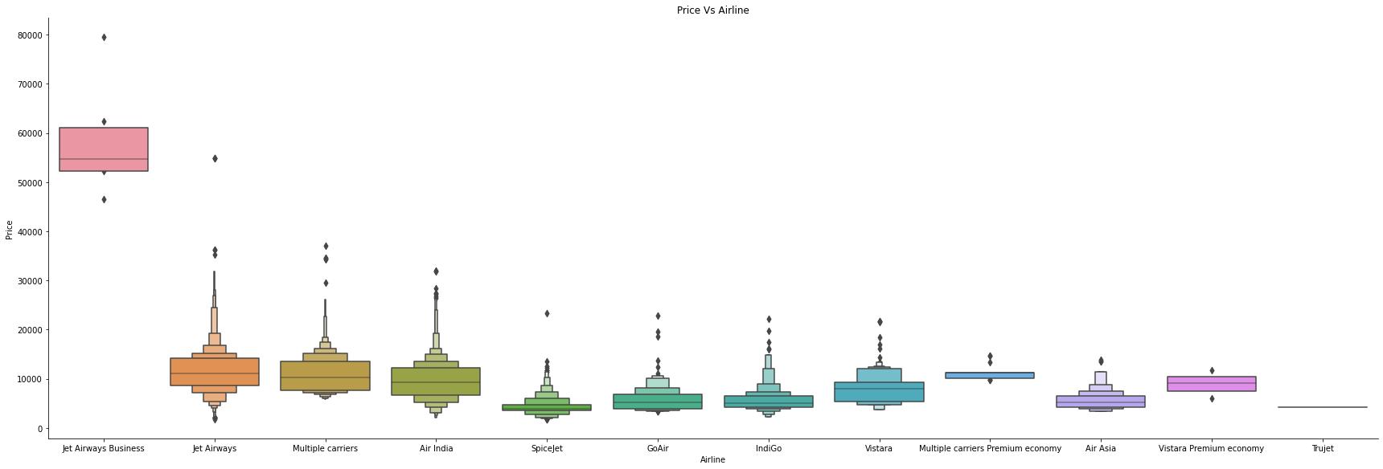
Airline vs price
We used catplot to visualize the relation of Airline with respect to Price, and by looking at the figure, we get to know that Jet Airways Business has very high price of tickets with respect to some other Airline. Whereas we can also see Trujet airline is very low in this .
Jet Airways , Indigo and Air India are the top 3 Airlines which has highest number of passengers
Jet Express Business has the highest average price of tickets.

Slide 14
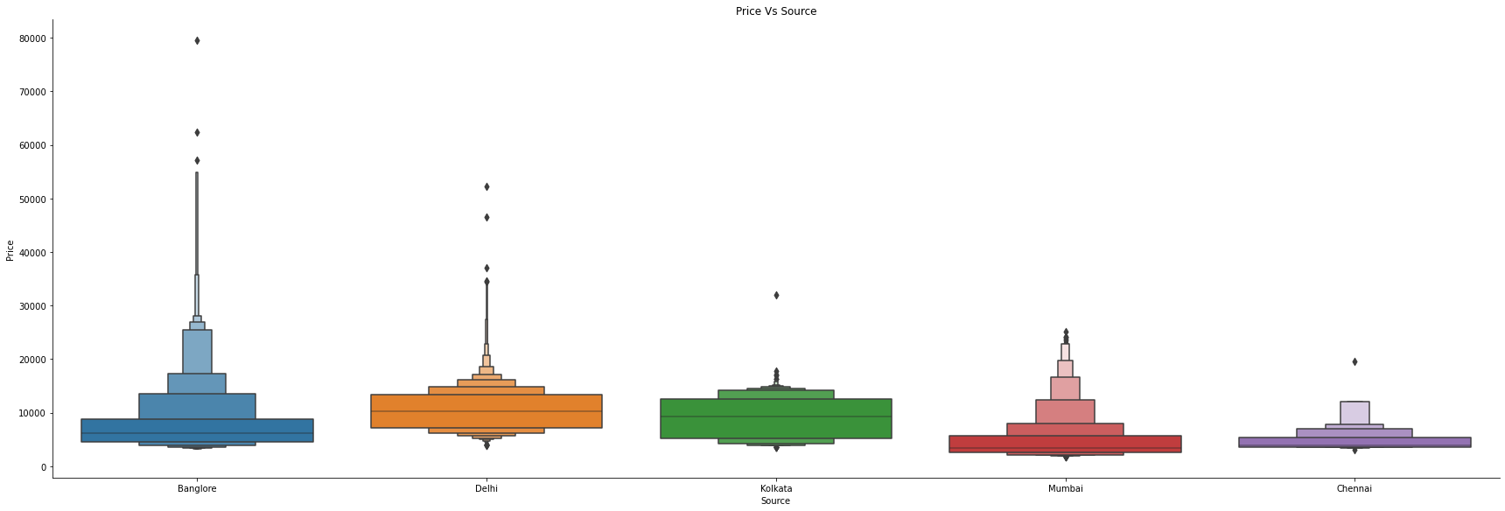
SOURCE VS PRICE
By looking at the source vs price figure, we can clearly say , Bangalore has most number of outliers.
Source Delhi has highest number of passengers i.e. 4537 with average price of 10539 which is again the highest average price among all source.
Kolkata has the second highest customer of 2871 with average price of price i.e. 9158.
Whereas Source Bangalore has the maximum of ticket which is 79512.

Slide 15
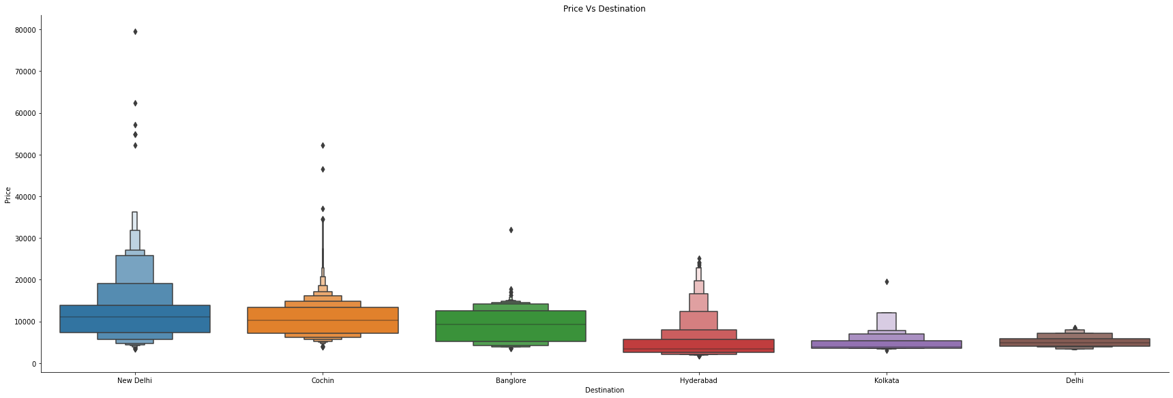
Destination VS Price
Destination Cochin makes the highest amount of business, with the highest number of passenger i.e. 4537 , with second highest in average price of ticket i.e. 10539 .
Bangalore is the second destination where most of the passenger likes to go , the total number of passenger of Bangalore is 2871 with 9158 average price of ticket.
By analysis, we can clearly see Delhi has the highest average price of tickets.

Slide 16
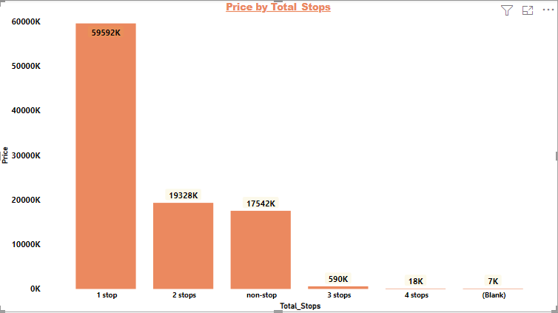
Price vs total_stops
In this visualization, we have compared the price with total stops.
We can clearly see, people like travelling to the flight which has only one stop. And some time for just one stop , the price of ticket becomes expensive. 1 stop has highest number of passenger i.e. 5625 and maximum price of ticket is 79512 , which is highest among all the stops.
We can also see stop has inverse relation to the Price. If the Stop is increasing then the price of ticket decreases wrt to the previous stops.

Slide 17
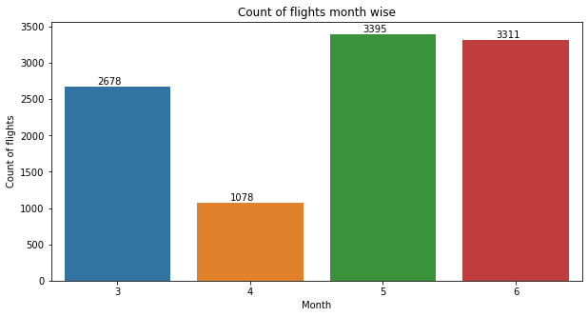
Here we can see the count of flight in each month, which also tells us that in which month passengers travels more.
By looking at the visualization, we can clearly see Month May has the highest no. of flights i.e. 3395 .
Month April has the lowest number of flight i.e. 1078.

Slide 18
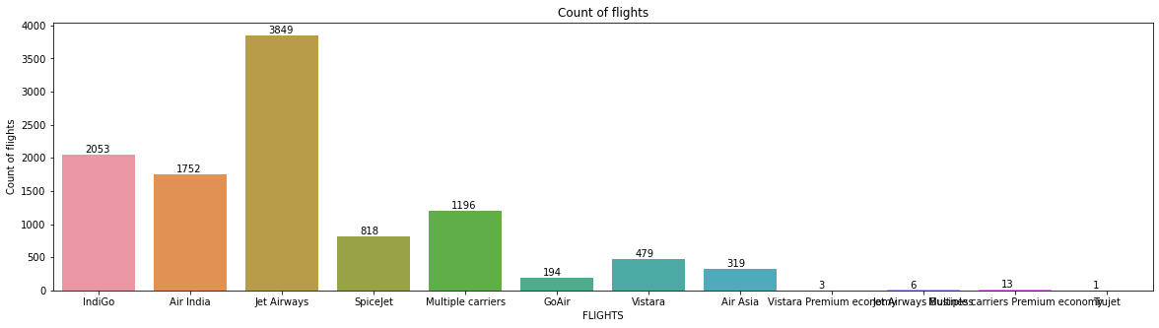
Here , we can see The count of flights of Jet Airways is the highest among all, which says us that the passengers first preference is Jet Airways.

Slide 19
Feature Engineering
This one is quite an intricate and laborious process, which consists of handling categorical data, feature scaling, dimensionality reduction, and feature selection. Besides, the key feature engineering methods applied at this stage include filter methods, wrapper methods, embedded methods, and feature creation. This basically entails the development of additional features that would enhance the model more than those that already exist. It requires different processes, including discretization, feature scaling, and data mapping to new spaces.

Slide 20
FEATURE SELECTION
The goal of feature selection techniques in machine learning is to find the best set of features that allows one to build useful models of studied phenomena.
There are many feature selection techniques but we will see only few:
Correlation Coefficient: Correlation is a measure of the linear relationship of 2 or more variables. Through correlation, we can predict one variable from the other. The logic behind using correlation for feature selection is that the good variables are highly correlated with the target. Furthermore, variables should be correlated with the target but should be uncorrelated among themselves.
LASSO Regularization (L1):Regularization consists of adding a penalty to the different parameters of the machine learning model to reduce the freedom of the model, i.e. to avoid over-fitting. In linear model regularization, the penalty is applied over the coefficients that multiply each of the predictors. From the different types of regularization, Lasso or L1 has the property that is able to shrink some of the coefficients to zero. Therefore, that feature can be removed from the model.

Slide 21
Handling categorical variable
Most Machine Learning Algorithm cannot handle categorical variable unless we convert them into numerical values. Let’s see some of the ways to handle categorical variable:
Label Encoding: One of the simplest and most common solutions advertised to transform categorical variables is Label Encoding. It consists of substituting each group with a corresponding number and keeping such numbering consistent throughout the feature. This solution makes the models run, and it is one of the most commonly used by aspiring Data Scientists.
One-Hot Encoding: One-Hot Encoding is the most common, correct way to deal with non-ordinal categorical data. It consists of creating an additional feature for each group of the categorical feature and mark each observation belonging (Value=1) or not (Value=0) to that group. It has some minor drawbacks, the high number of additionally generated features introduces the curse of dimensionality. This means that due to the now high dimensionality of the dataset, the dataset becomes much more sparse.

Slide 22
In our Dataset, we had columns like Airline , Source, Destination and Total stops as an object data type . So, before applying machine learning models , we must convert our data into numerical data.
As, Airline, Source and Destination are nominal data, so we applied One-Hot Encoding on them.
Total Stops column is ordinal data so we replaced their data by number based on their order.

Slide 23
Machine learning Models
Applying machine learning model is one of the most step in machine learning life cycle. There are many different types of machine learning algorithm that we can apply for our problem. We will look see some of the algorithm that we have applied for our problem:
1. Linear Regression
2. Random Forest

Slide 24
Linear Regression
In simple linear regression there's only 1 independent and one dependent feature but as our dataset consists of the many independent features on which the worth may rely on, we are going to be using multiple linear regression which estimates relationship between two or more independent variables and one dependent variable. The multiple linear regression models are represented by:
y=m1x1+m2x2+m3x3+………………….+ mnxn+ C
Where, y = the predicted value of the dependent variable
Xn= the independent variables
m= independent variables coefficients
C= y-intercept x

Slide 25
Random Forest:
Random Forest is an ensemble learning technique where training model uses multiple learning algorithms then combine individual results to urge a final predicted result. Under ensemble learning random forest falls into bagging category where random number of features and records will average value of the expected values if considered because the output of the random forest model.

Slide 26
Performance metrics
Performance metrics are statistical models which is able to be accustomed compare the accuracy of the machine learning models trained by different algorithms. The sklearn.metrics module are accustomed implement the functions to live the errors from each model using the regression metrics. Following metrics are accustomed check the error measure of every model.
1. MAE (Mean Absolute Error) Mean Absolute Error is basically the sum of average of the absolute difference between the expected and actual values.
MAE = 1/n [∑(y-ý)] y = actual output values,
ý = predicted output values
n = Total number of data points
Lesser the value of MAE better the performance of your model.

Slide 27
2. MSE (Mean Square Error) Mean Square Error squares the difference of actual and predicted output values before summing all rather than using absolute value.
MSE = 1/n [∑ (y-y^)2 ]
y=actual output values , y’=predicted output values
n = Total number of data points
Lower the value of MSE better the performance of the model.
3. RMSE (Root Mean Square Error) RMSE is measured by taking the square root of the average of the squared difference between the prediction and also the actual value
RMSE = √1/n [∑ (y-y^)2 ]
y=actual output values , y’=predicted output values
n = Total number of data points
RMSE is greater than MAE and lesser the value of RMSE between different models the
better the performance of that model.
4. (Coefficient of determination) The worth of R-square lies between 0 to 1. The closer its value to at least one, the higher your model is when comparing with other model values. There are different cross-validation techniques like GridsearchCV and RandomizedsearchCV which can be used for improving the accuracy of the model.
R2= 1 − ∑ ( y i − y i ^ ) 2 ∑ ( y i − y ¯ ) 2

Slide 28
Results
We had used two algorithms to prepared our ML model i.e., Linear Regression and Random Forest. From these two, Random Forest gives us the most accurate predictions. Models' performance using a few metrics are given below:
Linear Regression: MAE: 1989.475840451
MSE: 8584809.071996346
RMSE: 2929.98448323474
R2 SCORE: 0.6367799086465608
Random Forest: MAE: 1159.0048059537398
MSE: 3920052.4057357092
RMSE: 1979.91222172492
R2 SCORE: 0.9147644476401898

Slide 29
CONCLUSION
This project can result in saving money of inexperienced people by providing them the information related to trends of the flight prices and also give them a predicted value of the price which they use to decide whether to book ticket now or later. On working with different models, it was found out that Random Forest algorithm gives the highest accuracy in predicting the output.

